Slide 1

Department of ISE Internship Presentation
HEALTHCARE MANAGEMENT SYSTEM
Presented By:
LIKITH C
(1DB20IS070)
External Guide:
PAVITHRA S
(Senior Data Engineer)
Internal Guide:
Dr. Ugranada Channabasava
Associate Professor,
Dept.of ISE

Slide 2
Contents
Introduction
Company Profile
Certificate
Aim and Objective of internship
Internship Weekly report
Hardware and Software Requirements
ER Diagram
Snapshots
References

Slide 3
INTRODUCTION
The Healthcare Management System (HMS) is a digital solution designed to streamline various operations within healthcare facilities. It acts as a comprehensive tool, assisting healthcare professionals in managing administrative, financial, and clinical tasks efficiently.
By automating processes such as appointment scheduling, electronic health records management, and billing, the HMS enhances operational efficiency and ensures better patient care.
Moreover, it prioritizes data security by safeguarding sensitive patient information and adhering to regulatory standards. With its ability to optimize workflow and minimize errors, the HMS contributes to cost-effectiveness and overall improvement in healthcare delivery.

Slide 4

COMPANY PROFILE
Rapsol Technologies is Company Set up in Bengaluru with a motto “Web Design Development Training”.
Rapsol provides a resolution to the problems by incorporating services in all the areas by highlighting the key trends and challenges in the industry through unique marketing strategies.
Each service is customized and designed to offer for a particular industry or domain. The content and design of our unique services follow the detailed and optimal approach in order to convey our understanding of the business challenge and corresponding value proposition in a simple and lucid format.

Slide 5
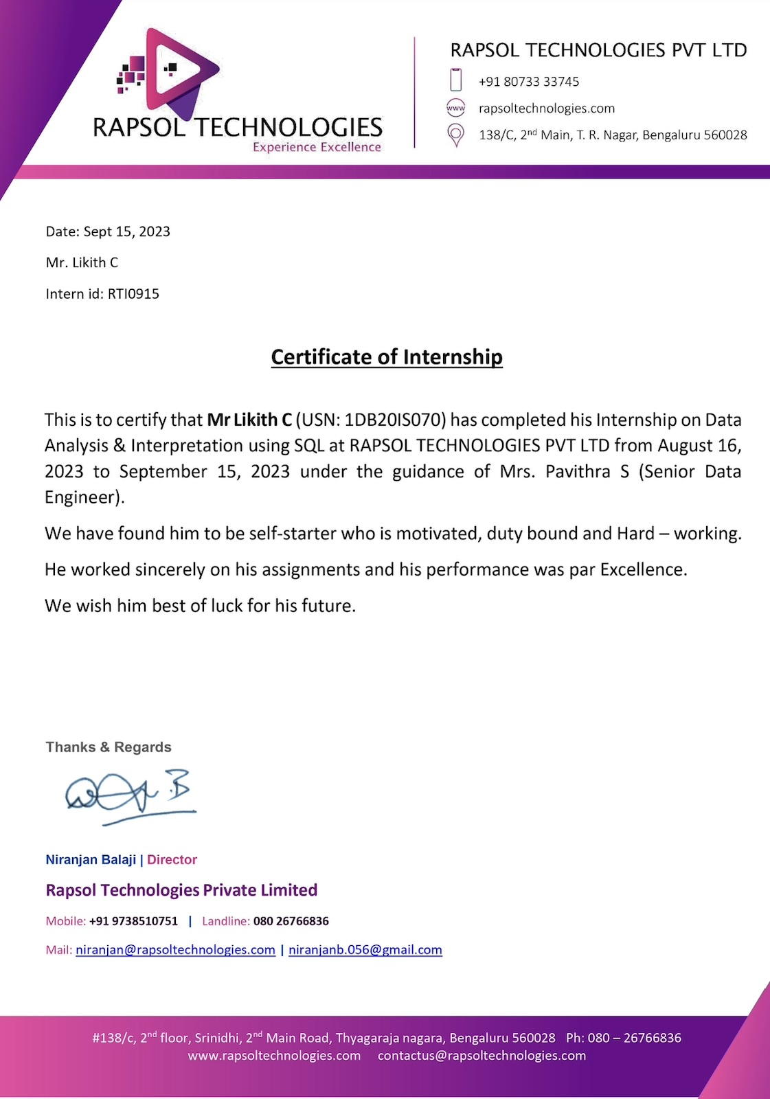
CERTIFICATE

Slide 6
AIM AND OBJECTIVE OF INTERNSHIP
Aim: To make healthcare facilities work better by using software to organize everything.
Objectives:
Efficiency: Make things quicker and easier for doctors and staff by automating tasks like booking appointments and managing records.
Patient Care: Help doctors give better care by giving them all the information they need about patients quickly.
Data Security: Keep patients' private information safe from hackers and make sure healthcare facilities follow the rules about patient privacy.
Smooth Operations: Make sure everything runs smoothly in healthcare facilities by using software to manage things like money, appointments, and records.
Saving Money: Help healthcare facilities save money by reducing paperwork, avoiding mistakes, and using resources wisely.

Slide 7
INTERNSHIP WEEKLY REPORT
Week 1:
Introduction to SQL and database concepts.
Setting up the development environment and database management system.
Learning basic SQL queries (SELECT, INSERT, UPDATE, DELETE).
Practicing queries on sample datasets.
Week 2:
Advanced SQL concepts (subqueries, joins, aggregations, and functions).
Working with real-world datasets and understanding data structure.
Performing data exploration and cleaning tasks using SQL.
Learning about database normalization and data modeling.

Slide 8
Week 3:
Introduction to window functions and advanced analytical queries.
Implementing complex data analysis tasks using SQL.
Exploring techniques for data summarization and reporting.
Understanding performance optimization techniques for SQL queries
Week 4:
Working on a real-world data analysis project or case study.
Applying learned SQL skills to extract insights and generate reports.
Presenting findings and recommendations to stakeholders.
Receiving feedback and suggestions for improvement.

Slide 9
SYSTEM REQUIREMENTS
SOFTWARE REQUIREMENTS
Programming language : SQL
Front end : HTML,CSS
Software : XAMPP
HARDWARE REQUIREMENTS
Operating system : Windows
Processor : Minimum intel i5
Ram : 8 GB

Slide 10
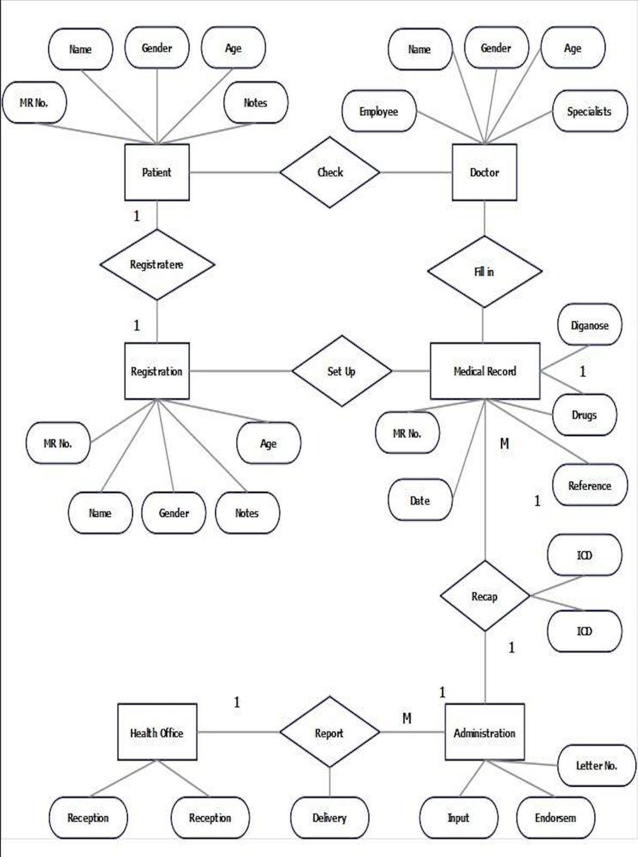
ER Diagram

Slide 11
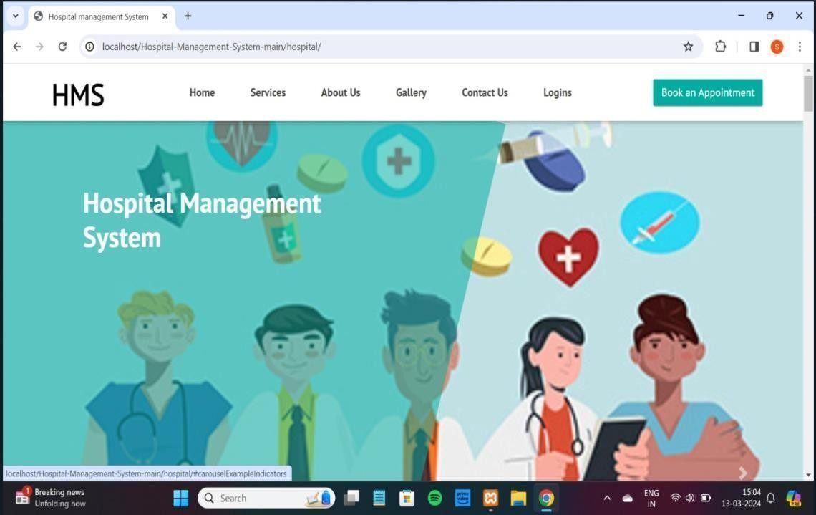
SNAPSHOTS
Home Page

Slide 12
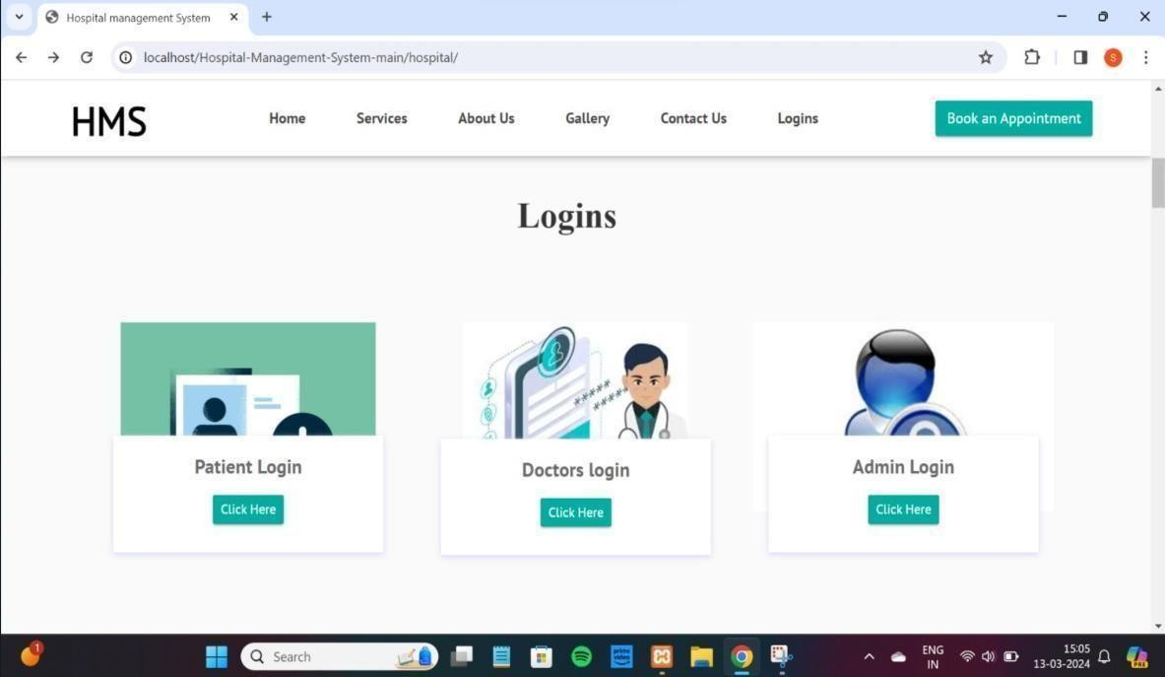
Login Page

Slide 13
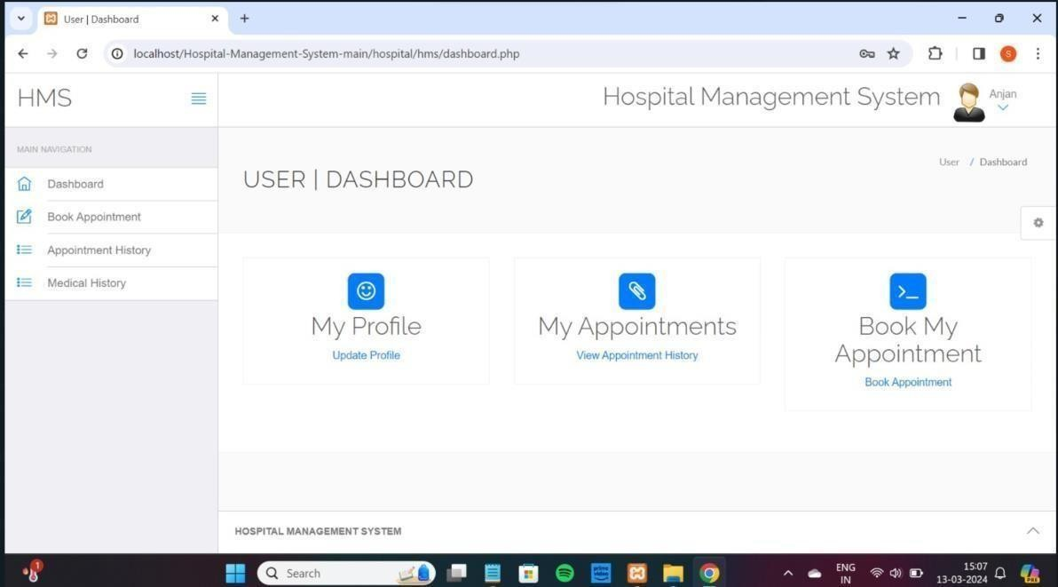
User Dashboard

Slide 14
REFERENCES
Fundamentals of Database Systems, and B. Navathe, 7th Edition, 2017,Pearson.
Database management systems, , and Gehrke, 3rd Edition, 2014, McGraw Hill.
https://en.wikipedia.org/wiki/Traffic_violations_reciprocity.
https://www.w3schools.in/mysql/.

Slide 15
THANK YOU

